Slide 1
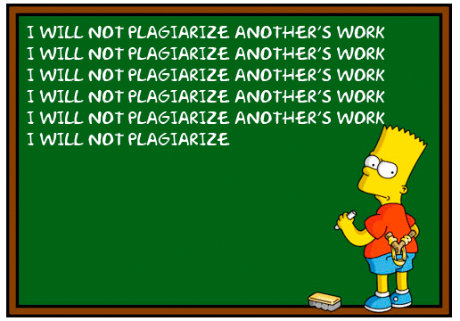
Avoiding Plagiarism

Slide 2
What is Plagiarism?

Slide 3
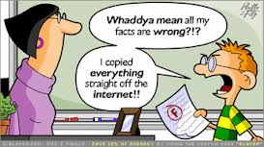
Plagiarism
The practice of taking someone else’s work or ideas and passing them off as one’s own.

Slide 4
Avoiding Plagiarism
Use the following strategies:
Paraphrase
Summarize
Quote
Cite your sources
Works Cited/Bibliography (at the end of your paper)
Parenthetical citations (in-text citation)

Slide 5
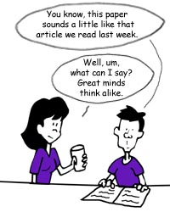
What does it mean to paraphrase?

Slide 6
Paraphrasing
Paraphrasing is writing or saying something that the other person has said or written in a different way.
Is changing 1-2 words paraphrasing???
You should change enough that it is your own words, although it’s someone else’s ideas
You paraphrase when:
You rework the source’s ideas, words, phrases, and sentence structures with your own.
You want to avoid overusing quotations
You want to use your own voice
Notes:
Is changing 1-2 words paraphrasing??? – it’s COPYING!!!
You should change enough that it is your own words, although it’s someone else’s ideas

Slide 7
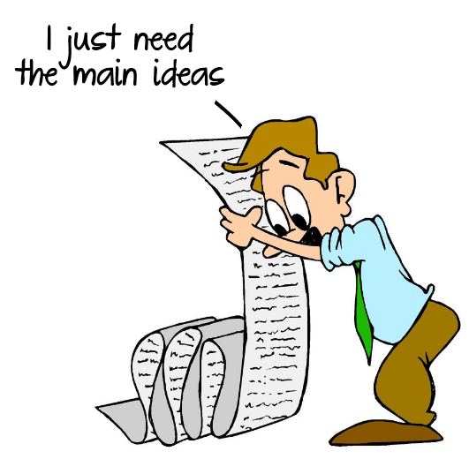
What does it mean to summarize?

Slide 8
Summarizing
Summarizing involves putting the main idea(s) of one or several writers into your own words, specifically the main point(s)
Summaries are significantly shorter than the original & take a broad overview of the source material.
Summarize when:
Establish background
Offer an overview of a topic
Describe knowledge about a topic
Determine the main idea of a single source

Slide 9
What does it mean to quote someone?

Slide 10
Quoting
Quotations are the exact words of an author, copied directly from a source, word for word.
Use quotes when:
Disagree with the author
Add the power of an author’s words to support your argument
Highlight powerful phrases or passages
Quotations must be cited!!!

Slide 11
Is this Plagiarism and why?
Original
Student work
The legal system is made up of civil courts, criminal courts and specialty courts such as family law courts and bankruptcy court. Each court has its own jurisdiction, which refers to the cases that the court is allowed to hear. In some instances, a case can only be heard in one type of court. For example, a bankruptcy case must be heard in a bankruptcy court. In other instances, there may be several potential courts with jurisdiction. For example, a federal criminal court and a state criminal court would each have jurisdiction over a crime that is a federal drug offense but that is also an offense on the state level.
The legal system is comprised of criminal and civil courts and specialty courts like bankruptcy and family law courts. Every one of the courts is vested with its own jurisdiction. Jurisdiction means the types of cases each court is permitted to rule on. Sometimes, only one type of court can hear a particular case. For instance, bankruptcy cases an be ruled on only in bankruptcy court. In other situations, it is possible for more than one court to have jurisdiction. For instance, both a state and federal criminal court could have authority over a criminal case that is illegal under federal and state drug laws.

Slide 12
Is this Plagiarism and why?
Original
Student work
Students frequently overuse direct quotation in taking notes, and as a result they overuse quotations in the final [research] paper. Probably only about 10% of your final manuscript should appear as directly quoted matter. Therefore, you should strive to limit the amount of exact transcribing of source materials while taking notes. Lester, James D. Writing Research Papers. 2nd ed. (1976): 46-47.
Students often use too many direct quotations when they take notes, resulting in too many of them in the final research paper. In fact, probably only about 10% of the final copy should consist of directly quoted material. So it is important to limit the amount of source material copied while taking notes.

Slide 13
To avoid plagiarism
Take thorough notes from all your sources
Use different color fonts, pens and pencils for each source
Distinguish your own ideas from those you found elsewhere
Mark page numbers
Write down bibliographic information or web addresses right away

Slide 14
Note Cards

Slide 15
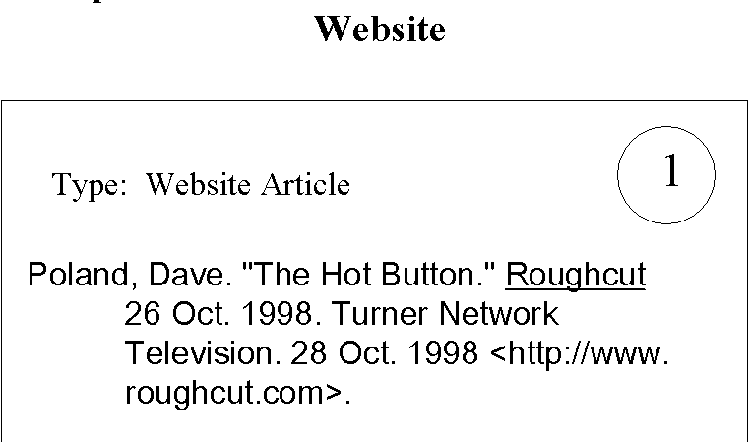

Slide 16
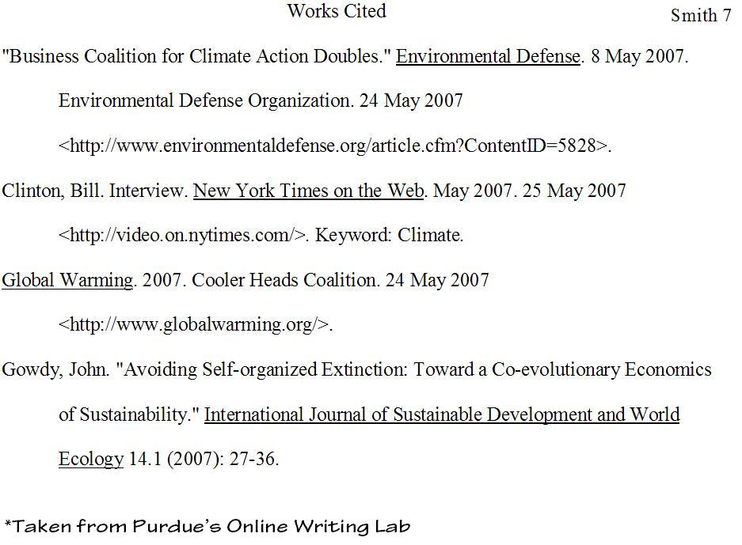
Works Cited Page

Slide 17
Your turn to test your knowledge
Please, type in this URL address and take the quiz
http://en.writecheck.com/plagiarism-quiz

